Slide 1
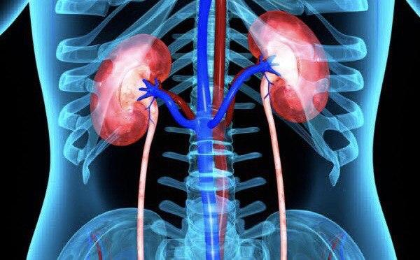
Diuretics
Diuretics are drugs that increase the volume of urine (diuresis). and sodium excretion (natriuresis)

Slide 2
RENAL TRANSPORT MECHANISMS
The kidney filters plasma water and solutes at the glomerulus at a very high rate (180 L/day) and must recover a significant percentage of most of these substances before excretion in the urine.
mechanisms for reabsorption of salt and water differ in each of the 4 major tubular segments, the diuretics acting in these segments have differing mechanisms of action.

Slide 3
Sites of diuretic drugs action

Slide 4
Prostaglandins (PG) are important in maintaining glomerular filtration. When synthesis of prostaglandins is inhibited, e.g. by NSAIDs, the efficacy of most diuretics decreases.

Slide 5
Classification of diuretics
1. High-efficacy (Potassium-depleting) loop diuretics example: furosemide, bumetanide
2. Moderate- efficacy (Potassium-depleting) diuretics
Thiazides & thiazide like diuretics: eg. Hydrochlorothiazide, chlorthalidone, metolazone, indapamide

Slide 6
3. Low efficacy diuretics
a. Potassium- sparing diuretic:
- Aldosterone antagonist: Spironolactone, eplerenone.
- Inhibitors of renal sodium channel: triamterene, amiloride.
b. Osmotic diuretics: Mannitol
c. Carbonic anhydrase inhibitors: Acetazolamide

Slide 7
Classes of drugs
1. Thiazides and thiazide- related diuretics:
Inhibit sodium reabsorption by inhibiting the Na+/Cl- transpoter in distal convoluted tubule
Efficacy is moderate; they cause 5- 10% of filtered sodium to be excreted, because nearly 90% of filtered sodium has already been reabsorbed before it reaches their site of action.

Slide 8
Hypokalaemia occurs because more amount of sodium is delivered to the distal nephrones, where it exchanges with potassium.
‘Ceiling’ of effect is low:
The dose response curve is flat; increasing the dose beyond a small range produces no additional diuresis.
Onset of action:
Slow - 2h (orally); so they are not suitable for emergency i.e. acute pulmonary oedema or sever hypertension.

Slide 9
Long duration of action:
(hydrochlorothiazide -12h, chlorthalidone -48 h). Allows once daily administration and given early in the morning so does not disturb patients’ sleep
They are ineffective in sever renal impairment and when GFR has fallen below 20 ml/min (except metolazone).
Chronic use reduce blood pressure in hypertensives due to thiazides-induced diuresis, in addition to vasodilatation which reduces the peripheral resistance, through increasing vasodilating PGS.

Slide 10
Renal calcium excretion is decreased
They are preferred on loop diuretics in calcium-deficient, elderly and osteoporotic individuals who are at risk of fractures.
The hypocalcuric effect of thiazides has also been used for prevention of hypercalciuria and renal calcium stones.
Hypomagnesemia: Renal Mg+2 excretion is increased
Hyperuricemia: Serum uric acid level is increased because diuretics are organic acids and compete with uric acid for proximal tubular secretion.

Slide 11
Clinical uses
1. Hypertension
2. Oedema due to heart failure, renal and hepatic diseases.
3. Nephrogenic diabetes insipidus.
4. Hypercalciuria with recurrent renal calcium stones

Slide 12
2. Loop diuretics
Furosemide is prototype
Mechanism and Site of action: inhibit sodium reabsorption by inhibiting Na+/K+/2Cl- transporter in the ascending loop of Henle.
Efficacy is high; cause up to 25% of filtered Na+ to be excreted.
’Ceiling’ of effect is high (diuresis goes on increasing with increasing dose) . Over-treatment can cause dehydration.

Slide 13
Onset of action rapid -furosemide (i.v. 30 min), (oral 1 h); therefore it is suitable for emergency situations as acute pulmonary oedema and hypertensive crisis.
Duration of action: Short- (6h), so if given late during a day it does not disturb sleep.
Hypokalaemia occur by same mechanism as thiazides.
Loop diuretics remain effective in severe renal impairment and at GFR below 10ml/min.

Slide 14
Renal Ca+2 excretion is increased. This is utilized in treatment of hypercalcaemia. On other hand they are not preferred in elderly, osteoporotic and calcium deficient, loop diuretics use is associated with an increased risk of fractures.
Renal Mg+ excretion is increased.
Serum uric acid is increased (by same mechanism as thiazides).

Slide 15
Clinical uses
1. acute pulmonary oedema and acute left ventricular failure
2. oedema due to renal or hepatic diseases
3. hypertensive emergencies, hypertension associated with renal failure or congestive heart failure
4. hypercalcaemia & hyperkalaemia
5. cerebral oedema
6. renal failure

Slide 16
Side effects of diuretics
1. Hypokalaemia: risk is more with low dietary K+ intake, concurrent use of other drugs that cause hypokalaemia as β2- agonists, theophylline and corticosteroids, GIT diseases that cause electrolyte loss as vomiting or diarrhea.
Hypokalaemia causes arrhythmias.
It can be prevented or treated by high dietary potassium intake, supplement of KCl tablets or combining potassium- depleting with potassium- sparing diuretics

Slide 17
2. hyponatraemia and hypovolaemia
3. hypotension
4. hypomagnaesemia
5. hypercalcaemia due to thiazides and hypocalcaemia due to loop diuretics
6. hyperuricaemia; gout may occur
7. Hyperglycemia
8. hyperlipidaemia
Other side effects: Thiazides: thrombocytopenia, agranulocytosis, photosensitivity, dermatitis.
Loop diuretics (furosamide): Ototoxicity

Slide 18
Drug interactions of loop and thiazide diuretics
1. Hypokalaemia induced by these drugs enhances digoxin toxicity.
2. NSAIDs reduce effect of diuretics by inhibiting synthesis of renal vasodilator PGs.
3. Loop diuretics potentiate aminoglycosides-induced ototoxicity.
4. Furosemide displaces warfarin from plasma protein binding site.

